Slide 1


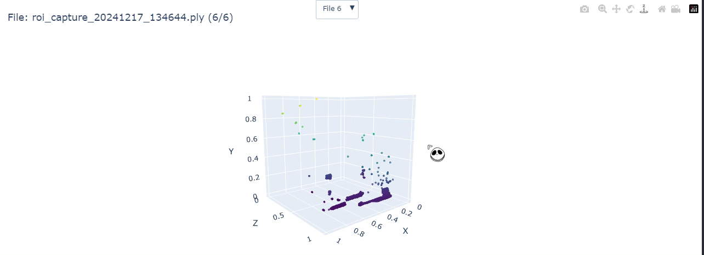
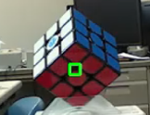
CONTINUE FROM 18/12 Week
Incorrect 3D file scanning and rendering

Slide 2
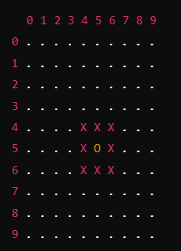
CAUSE OF PROBLEMS
The ROI defined is in 2D-pixel space, representing the coordinates on the camera's image plane, while the point cloud is in 3D space with x, y, and z coordinates in the camera's 3D world coordinate system.
This mismatch can cause the following issues:
Points outside the desired region (in 3D) may still be included in the point cloud.
Valid points in the depth range might not align correctly with the 2D pixel-based ROI.
O = Object
X = ROI
2D ROI in image plane

Slide 3
FIXES THE PROBLEMS
Map 2D ROI to 3D Space
Convert the 2D pixel ROI into 3D coordinates using the depth map.
Filter the 3D points in the point cloud based on the mapped 3D ROI.
Map 3D ROI directly
Specify the 3D bounding box explicitly
Using real-world coordinates (x_min, x_max, y_min, y_max, z_min, z_max) in the camera's 3D space.

Slide 4
DEFINING THE ROI DIRECTLY IN 3D
How It Works: Specify the 3D bounding box explicitly, using real-world coordinates (x_min, x_max, y_min, y_max, z_min, z_max) in the camera's 3D space.
Aspect | Define in 3D Directly
Advantages | Precise and directly uses real-world dimensions in meters. Avoids errors or misalignment when mapping from 2D to 3D. Independent of camera resolution and image distortions. - Requires less computation compared to 2D-to-3D mapping.
Disadvantages | Harder to visualize ROI without experience in 3D space. Not easy for image-based selections. - Requires manual calculation of 3D bounding box coordinates.
When to Use | Known 3D coordinates or static physical setups with precise dimensions. Applications where real-world physical measurements in meters are critical. - Tasks focused entirely on 3D data without involving the 2D camera feed.

Slide 5
TRANSFORMING A 2D ROI INTO 3D
How It Works: Start with a 2D bounding box on the image plane (e.g., x1, y1, x2, y2 in pixels) and use the depth frame to calculate corresponding 3D coordinates.
Aspect | Transforming a 2D into 3D
Advantages | Easy to define on images (especially for live camera feeds). Suitable for interactive/dynamic ROIs. Works well when combining 2D and 3D data in the workflow.
Disadvantages | Requires additional computation for 2D-to-3D transformation. Precision depends on depth resolution, which may lead to errors. Dependent on accurate camera intrinsics for proper 2D-to-3D mapping.
When to Use | Tasks where ROI needs to be dynamically selected on the camera feed. Applications combining 2D image processing and 3D point cloud data. Projects where interactive tools or annotations are involved.

Slide 6
COMPARISON
Which is Better?
Aspect | Define in 3D Directly | Transform 2D ROI to 3D
Precision | High (real-world dimensions) | Moderate (depends on depth data)
Ease of Use | Requires familiarity with 3D space | Easy to define on images
Visualization | Harder | Easier (image-plane visualization)
Computation | Fast (no 2D-to-3D mapping) | Slower due to transformation step
Flexibility | Best for physical setups | Best for interactive tools

Slide 7
RECOMMENDATION
Define ROI in 3D Directly: Use this if:
Work with static objects with known positions.
Prefer precise control over dimensions in meters.
Transform 2D ROI to 3D: Use this if:
Need to select regions in the image feed dynamically.
Work with applications that involve both 2D and 3D visualizations.
Defining the ROI directly in 3D is better for precise and efficient while directly using real-world dimensions, as it avoids the complexity and potential inaccuracies of mapping from 2D to 3D

Slide 8
NEXT STEPS
Define the 3D ROI:
Use known real-world coordinates (e.g., x_min, x_max, y_min, y_max, z_min, z_max) to define a bounding box directly in 3D space.
Apply Depth Noise Reduction:
Use RealSense depth filters such as decimation, spatial, and temporal filters to smooth depth data and fill gaps.
Capture and Save Filtered Point Cloud:
Ensure the point cloud data is filtered based on the defined 3D ROI and depth range (DEPTH_MIN and DEPTH_MAX) before saving.
Normalize and Clean Data:
Normalize the captured 3D points to fit within a unit cube.
Remove outliers using statistical outlier removal techniques for cleaner data.
Visualize the Point Cloud:
Use visualization tools like Open3D or Plotly to inspect the captured 3D map and validate its accuracy.
Refine Alignment:
Apply rotation or transformation matrices to align the captured map with the desired coordinate system.
Iterate and Debug:
Test the workflow with different objects or environments to ensure consistent and accurate mapping.
Export and Use:
Save the final map in formats like PLY, PCD, or OBJ for further analysis or application in simulations and modeling.

